Slide 1
Deploying a Micro service in Kubernetes
SR. DEvoPs engineer
Pradeep Kumar chitroliya

Slide 2
Session Agenda
Introduction & Real-World Relevance
Prerequisites & Core Concepts
Architecture & Workflow
Hands-On Demo
Production Considerations
Summary & Q&A

Slide 3
1. Introduction — The Problem We're Solving
MicroService: Micro services is an architectural approach in which a large application is divided into multiple small, independent, and loosely coupled services. Each service is responsible for a specific business functionality, can be developed and deployed independently, and communicates with other services through well-defined APIs such as REST, gRPC, or messaging.
1.1 The Pain Point (Before Kubernetes)
Imagine a team ships a micro service. It runs fine on the developer's laptop. In production it needs to run on multiple servers, restart itself if it crashes, scale up during traffic spikes, roll out updates without downtime, and be discoverable by other services. Doing all of this manually with shell scripts and cron jobs does not scale past a handful of services.
1.2 What Kubernetes Actually Does
Kubernetes (K8s) is a container orchestration platform. Given a container image and a description of the desired state ("I want 3 replicas of this
service, always healthy, reachable on port 80"), Kubernetes continuously works to make the actual state match that desired state. This is the single
most important mental model for the entire session: Kubernetes is a reconciliation loop, not a task runner.

Slide 4
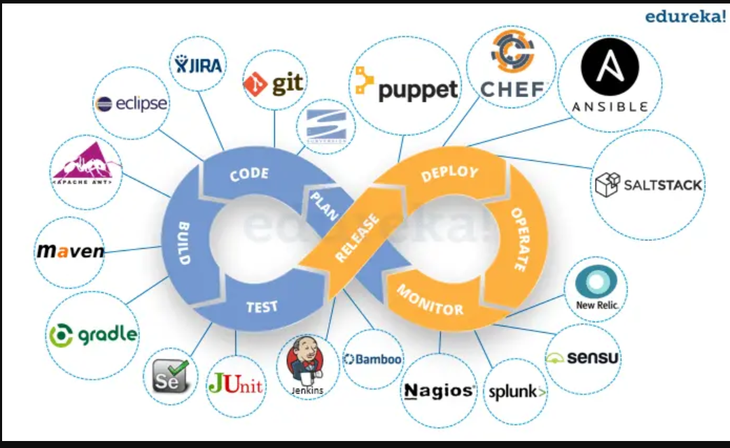
1.2 Where This Fits in the DevOps Lifecycle

Slide 5
2.1 Prerequisites & Core Concepts (From Basics)
2.1 What Learners Should Already Know
A container image is a portable, immutable package containing your application code, its runtime, and all dependencies. A container is a running instance of that image. Kubernetes never touches your source code — it only ever schedules and runs images
Prerequisite | Why it matters
Basic Linux shell | Every command we run is from a terminal
Docker fundamentals | Kubernetes runs containers — it does not build them
Basic YAML syntax | Every Kubernetes object is described declaratively in YAML
Client-server / REST basics | Our demo micro service exposes an HTTP API

Slide 6
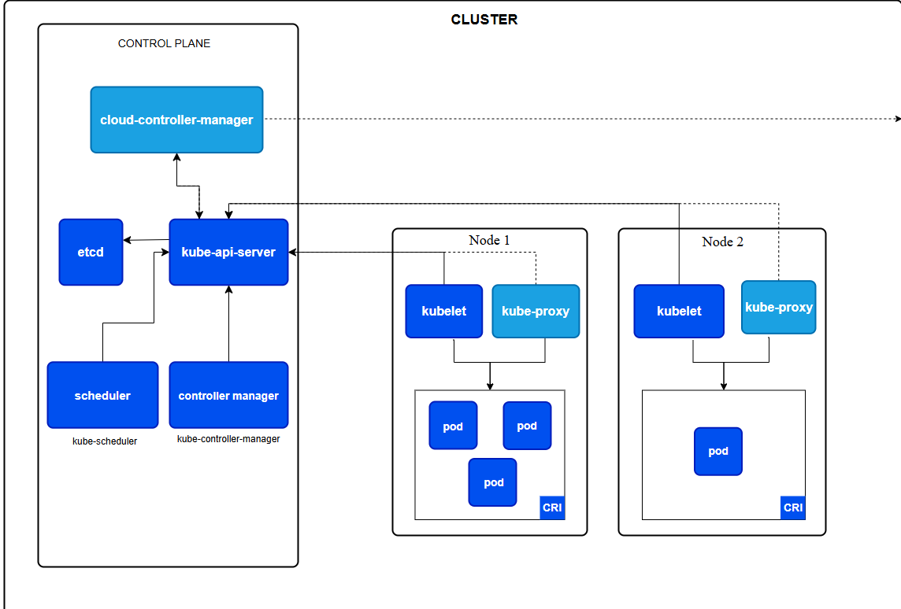
3 Kubernetes Cluster Architecture

Slide 7
2.2 Core Kubernetes Building Blocks
Object | Analogy | What it actually does
Pod | A single "instance" of your app | Smallest deployable unit; wraps one or more tightly-coupled containers sharing network & storage
Deployment | The manager/supervisor | Declares how many Pod replicas should exist and how to roll out updates; self-heals crashed Pods
Replica Set | The headcount enforcer | Created automatically by a Deployment; ensures exactly N Pods are always running
Service | A stable phone number | Gives a fixed IP/DNS name that load-balances traffic across Pods, even as Pods are replaced
Namespace | A virtual folder | Logical isolation of resources (e.g. dev, staging, prod) within one cluster

Slide 8
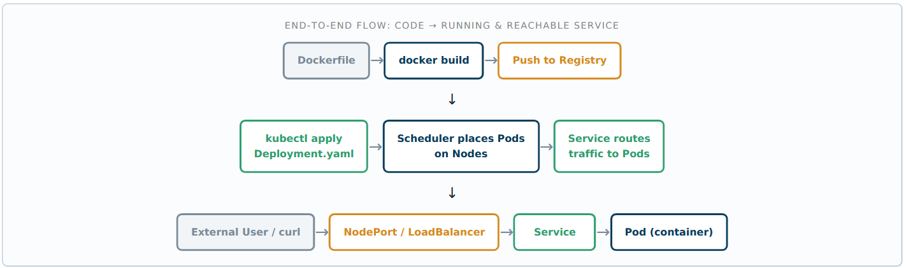
3.2 Request & Deployment Flow for Our Micro service

Slide 9
4. Hands-On Demonstration
Write the Micro service
Containerize It
Push the image to a Registry
Start a Local Cluster
Write the Deployment Manifest
Write the Service Manifest
Apply & Verify

Slide 10
Thank
You

